Slide 1
UNIT 5: “Work and business”
Grammar:
“RELATIVE CLAUSES”

Slide 2
1. DEFINING RELATIVE CLAUSES
DEFINING relative clauses make clear which person or thing we are talking about. They are ESSENTIAL to understand the meaning of the sentence. (Es decir, no podemos quitarlo o la frase no tendría sentido).
For example:
The man who cuts my hair has gone to another hairdresser’s.
The man has gone to another hairdresser’s.
In the second sentence, we are not given any information about the man, so the sentence doesn’t carry all the meaning it could.

Slide 3
1.1. RELATIVE PRONOUNS IN DEFINING RELATIVE CLAUSES
We use who or that when we are talking about people.
Paul is the person who/that deals with all the internet stuff.
We use which or that when we are talking about things.
The video game which/that was releases yesterday is great.
We use where to talk about places.
It’s a website where people can find accommodation.
We use when to talk about time, but is often replace by that.
2015 was the year when we set up our business.
We use whose to talk about possession.
I met a man whose brother is an astronaut.

Slide 4
1.2. OMISSION OF RELATIVE PRONOUNS
We can omit the relative pronoun in DEFINING relative clauses when the relative pronoun is the object of the verb:
/Es decir, podemos omitir el pronombre relativo cuando este pronombre es el complemento del verbo./
A smartphone is the only electronic device (that) I use. ¿Cuál es el dispositivo que uso? → A smartphone. OBJECT
Object
Harry is the boy (who) I met at the party. ¿A quién conocí yo en la fiesta? → Harry. OBJECT
Object
En ambas frases, el sujeto es ”I” (Yo) por lo tanto, los complementos son: ”A smartphone” y “Harry”. Como ambos complementos están siendo definidos, es decir, que están explícitos en las frases, podemos omitir los pronombres relativos correspondientes, quedando así:
A smartphone is the only electronic device I use.
Harry is the boy I met at the party.

Slide 5
2. NON-DEFINING RELATIVE CLAUSES
NON-DEFINING relative clauses are clauses that are NOT ESSENTIAL (esto significa que podemos prescindir de esa parte, se puede quitar) to understand the sentence. However, they give us extra info:
Example A: Harry Houdini was born in Hungary. His real name was Ehrich Weiss. In this example, the first sentence has the main info and the second provides extra info.
Example B: Harry Houdini, whose real name was Ehrich Weiss, was born in Hungary. In this example, we have incorporated the extra info (sentence 2) into the sentence 1 in the form of a non-defining relative clause and with commas.

Slide 6
2.1. THE USE OF COMMAS
When we add a non-defining relative clause, we always use a (,) before and after the clause. (,non-defining relative clause,) *1
If the clause is at the end of the sentence, we put a (,) before and we end with a full stop (.) *2
*1: The Prado Museum, which is visited by thousands of people every year, is in Madrid. (ponemos coma antes y después de la non-defining clause)
*2: Alex’s favourite video game is Minecraft, which was created by the Swedish programmer Markus Persson. (ponemos la coma antes de la non-defining clause y se termina con un punto final).

Slide 7
2.2. RELATIVE PRONOUNS IN NON-DEFINING RELATIVE CLAUSES
In non-defining relative clauses we use:
who → people (*1)
which → things (*2)
WE DON’T USE THAT. THAT:
(*1): Harry Houdini, who is my hero, came from Hungary.
No decimos: …., that is my hero, …
(*2): The Tower of London, which is very popular with tourists, is located on the north bank of the River Thames.
No decimos: …, that is very popular with tourists, …

Slide 8
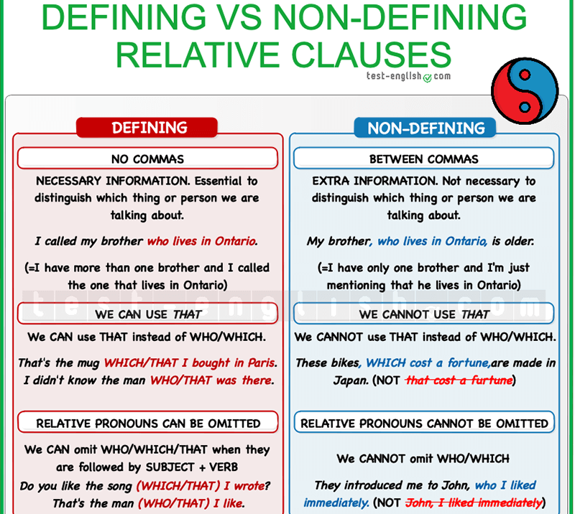
Summary

Slide 9
Verbs with prepositions
We have two situations:
Informal style | Formal style
VERB + PREPOSITON Use the kit which you’ve been provided with. Jesse Owens is the athlete who we heard about. | PREPOSITION + WHICH / WHOM Please use the kit with which you have been provided. Jesse Owens is the athlete about whom we heart.

